Slide 1

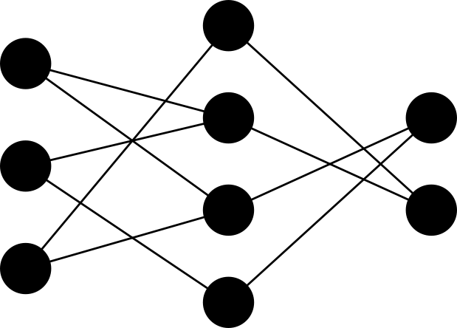

Exploring Complexity Reduction in Deep Learning
Sourya Dey
PhD Candidate, University of Southern California
Advisors: Peter A. Beerel and Keith M. Chugg
November 18, 2019

Slide 2

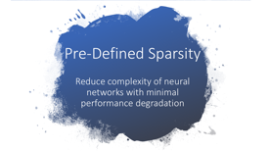

Outline

Slide 3

Pre-Defined Sparsity Reduce complexity of neural networks with minimal performance degradation

Slide 4
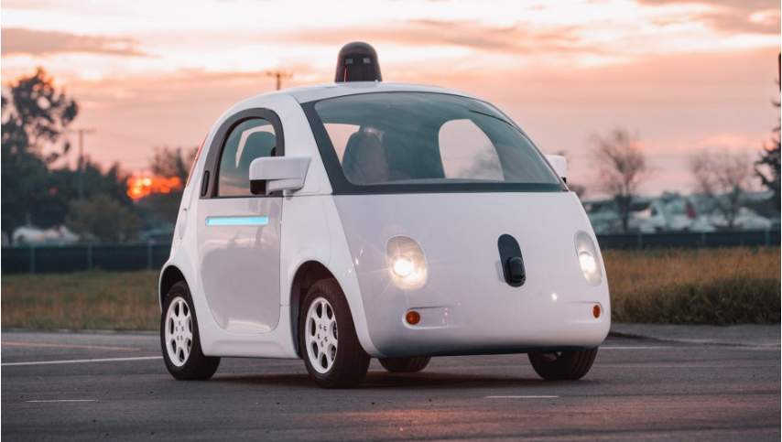

Overview
Neural networks (NNs) are key machine learning technologies
Artificial intelligence
Self-driving cars
Speech recognition
Face ID
and more smart stuff …

Slide 5
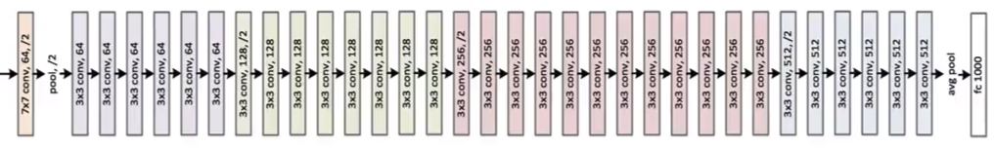
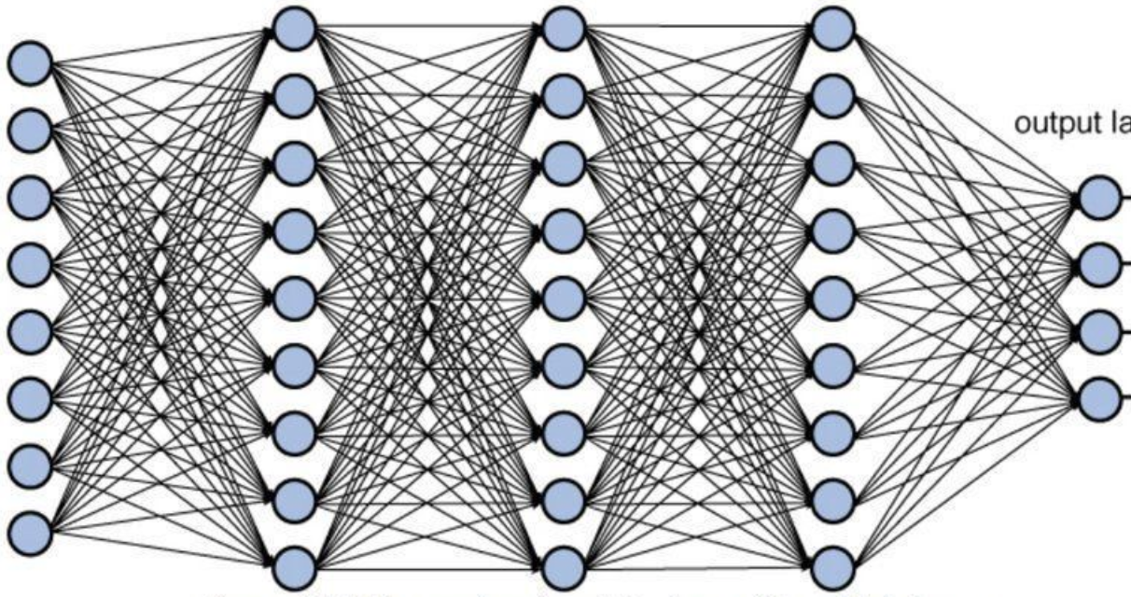

Motivation
Modern neural networks suffer from parameter explosion
Typical deep CNN
Training can take weeks on CPU
Cloud GPU resources are expensive
Fully connected (FC) Multilayer Perceptron (MLP)
Notes:
Our research plans to empower entities to use deep learning cheaply

Slide 6
The Complexity Conundrum
Feedforward (FF)
Storage and computational complexity dominated by weights
All the weights are used in all 3 operations
Backpropagation (BP)
Update parameters (UP)

Slide 7
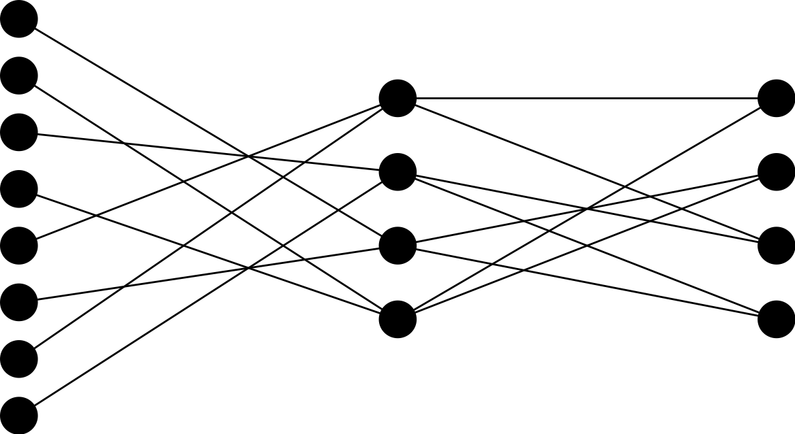
Our Work: Pre-defined Sparsity
Structured Constraints: Fixed in-, out-degrees for every node
Pre-define a sparse connection pattern prior to training
Use this sparse network for both training and inference
Reduced training and inference complexity
Overall Density compared to FC
Notes:
different from some works which removes wts later
different from dropout - train many networks

Slide 8
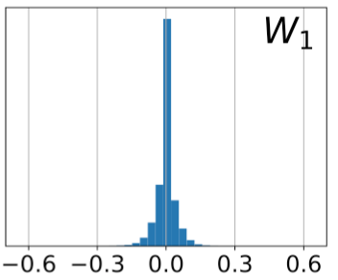
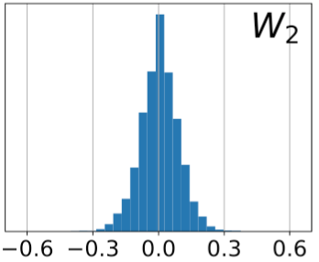
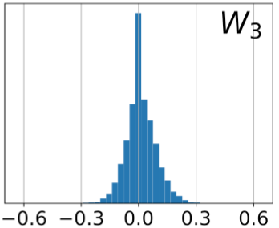
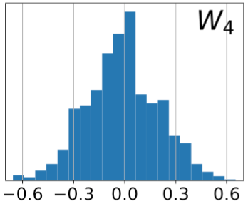
Motivation behind pre-defined sparsity
In a FC network, most weights are very small in magnitude after training

Slide 9
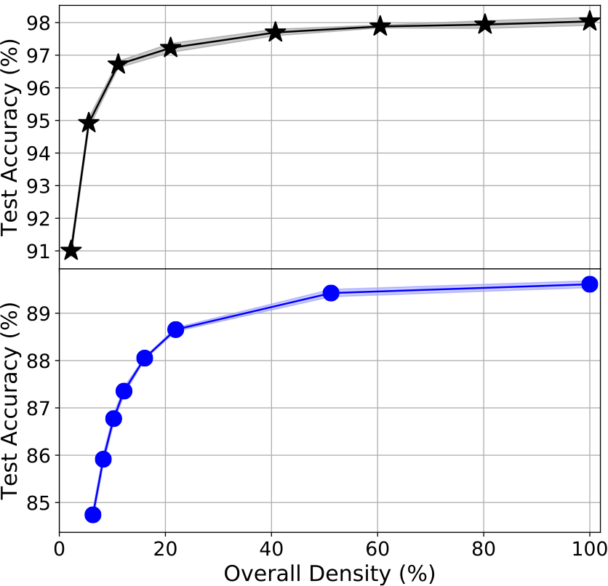
Pre-defined sparsity performance on MLPs
Starting with only 20% of parameters reduces test accuracy by just 1%
MNIST handwritten digits
Reuters news articles
TIMIT phonemes
CIFAR images
S. Dey, K. M. Chugg and P. A. Beerel, “Morse Code Datasets for Machine Learning,” in ICCCNT 2018. Won Best Paper award.
https://github.com/usc-hal/morse-dataset
Morse symbols

Slide 10
Analysis and Applications Deep dive into pre-defined sparsity for MLPs and a corresponding hardware architecture for both training and inference

Slide 11
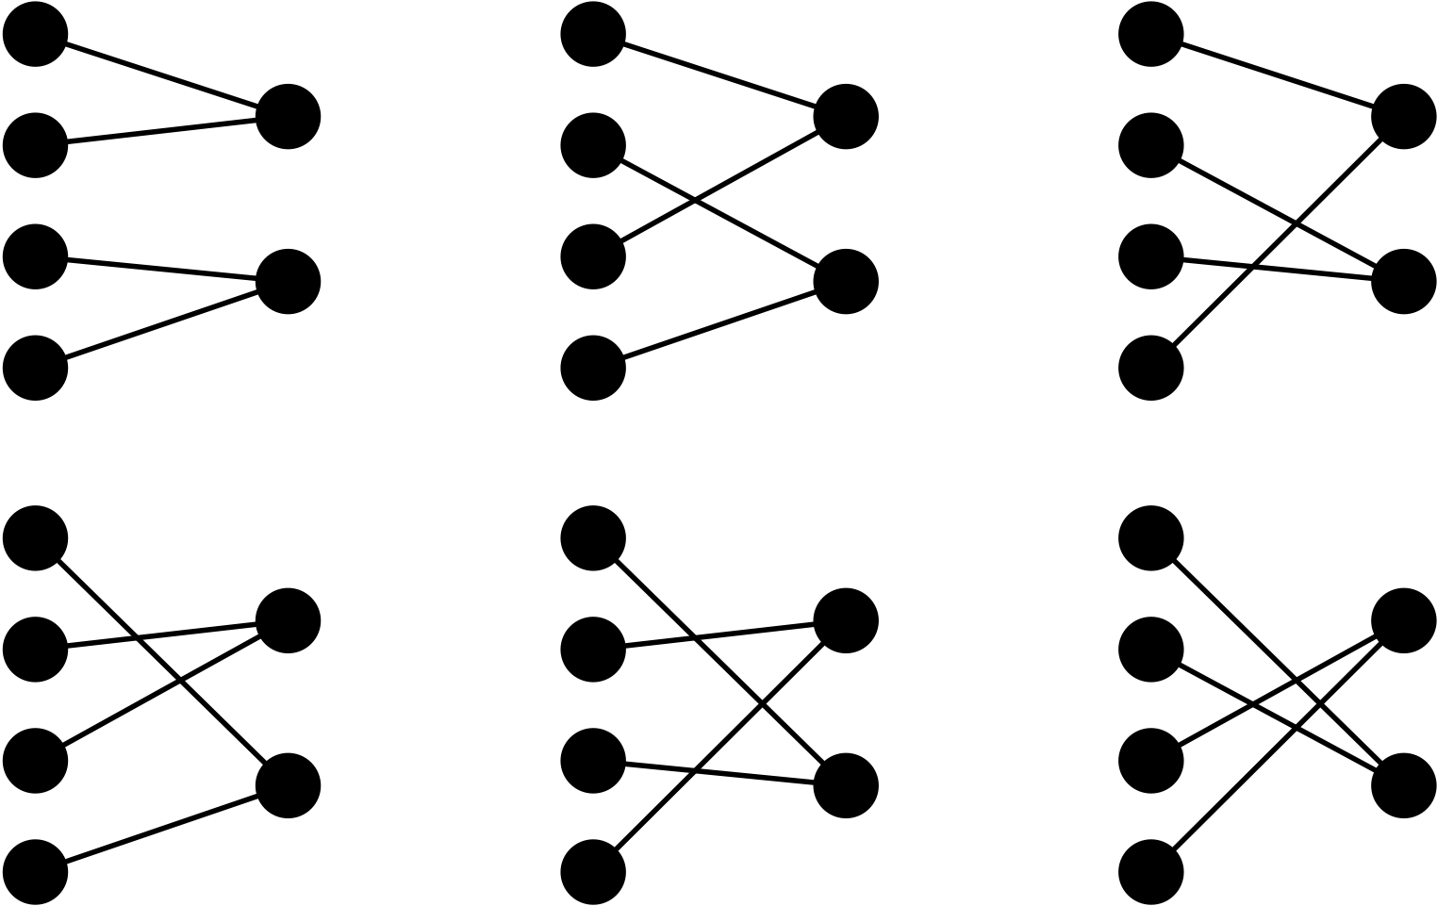
Designing pre-defined sparse networks
A pre-defined sparse connection pattern is a hyperparameter to be set prior to training
?
?
?
?
?
Find trends and guidelines to optimize pre-defined sparse patterns
S. Dey, K. Huang, P. A. Beerel and K. M. Chugg, "Pre-Defined Sparse Neural Networks with Hardware Acceleration," in IEEE Journal on Emerging and Selected Topics in Circuits and Systems, vol. 9, no. 2, pp. 332-345, June 2019.

Slide 12
Individual junction densities
Latter junctions (closer to the output) need to be denser

Slide 13
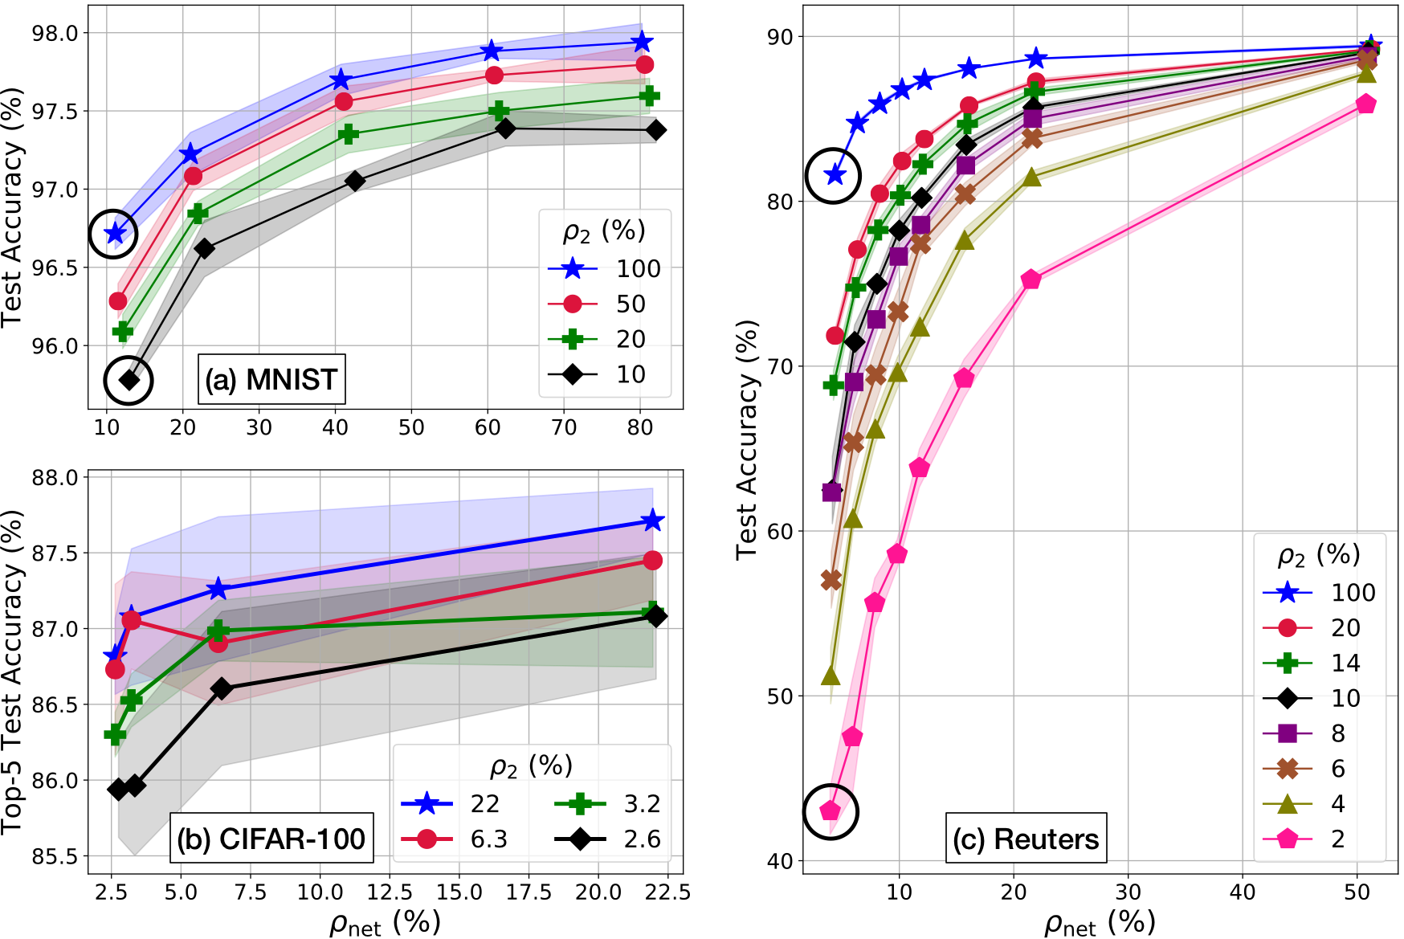
Individual junction densities
Each curve keeps 𝜌₂ fixed and varies 𝜌_{net} by varying 𝜌₁
For the same 𝜌_{net} , 𝜌₂ > 𝜌₁ improves performance
Mostly similar trends observed for deeper networks

Slide 14
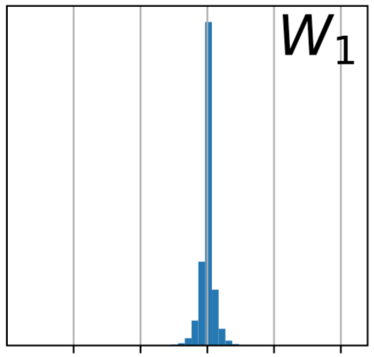
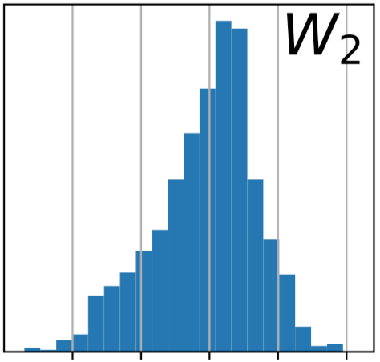
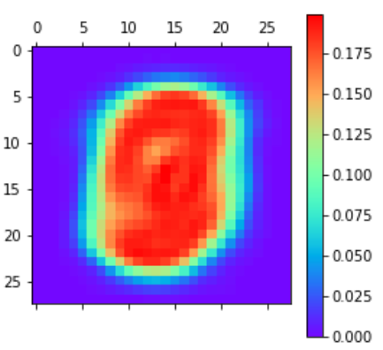
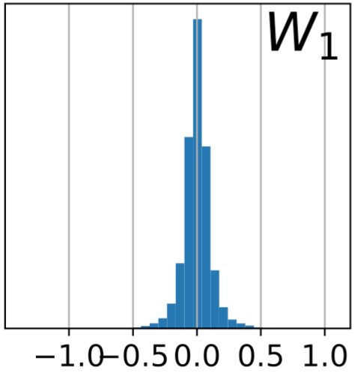
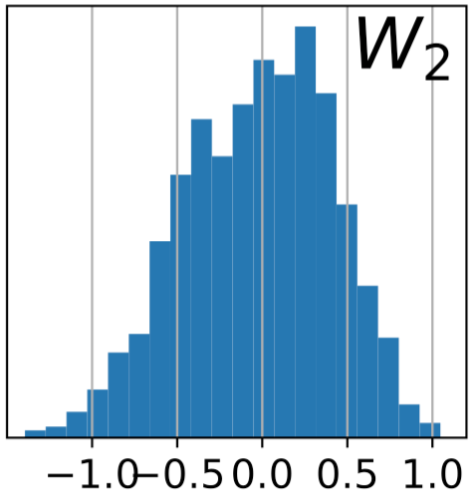
Dataset redundancy
MNIST with default 784 features
High redundancy
Low redundancy
MNIST reduced to 200 features
Wider spread
Less redundancy => Less sparsification possible

Slide 15
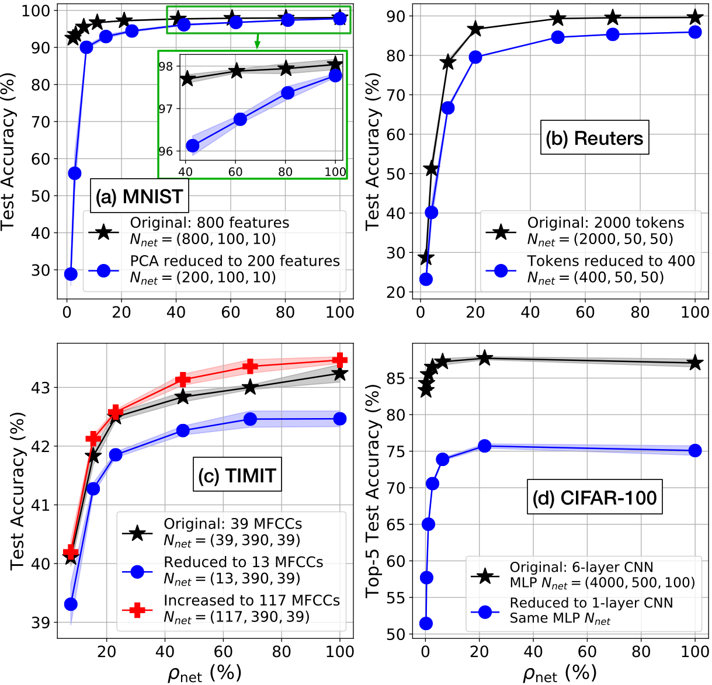
Effect of redundancy on sparsity
Reducing redundancy leads to increased performance degradation on sparsification

Slide 16
‘Large sparse’ vs ‘small dense’ networks
A sparser network with more hidden nodes will outperform a denser network with less hidden nodes, when both have same number of weights

Slide 17
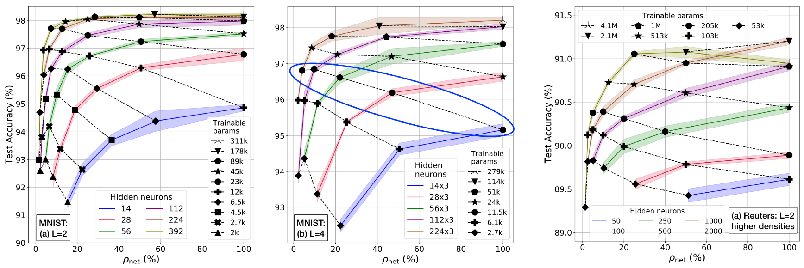
‘Large sparse’ vs ‘small dense’ networks
Networks with same number of parameters go from bad to good as #nodes in hidden layers is increased

Slide 18
Regularization
Pre-defined sparse networks need smaller λ (as determined by validation)
Overall Density | λ
100 % | 1.1 x 10⁻⁴
40 % | 5.5 x 10⁻⁵
11 % | 0
Regularized cost
Original unregularized cost (like cross-entropy)
Example for MNIST 2-junction networks
Regularization term
Pre-defined sparsity reduces the overfitting problem stemming from over-parametrization in big networks
Notes:
and don’t just have a small network. remember large sparse is better than small dense

Slide 19
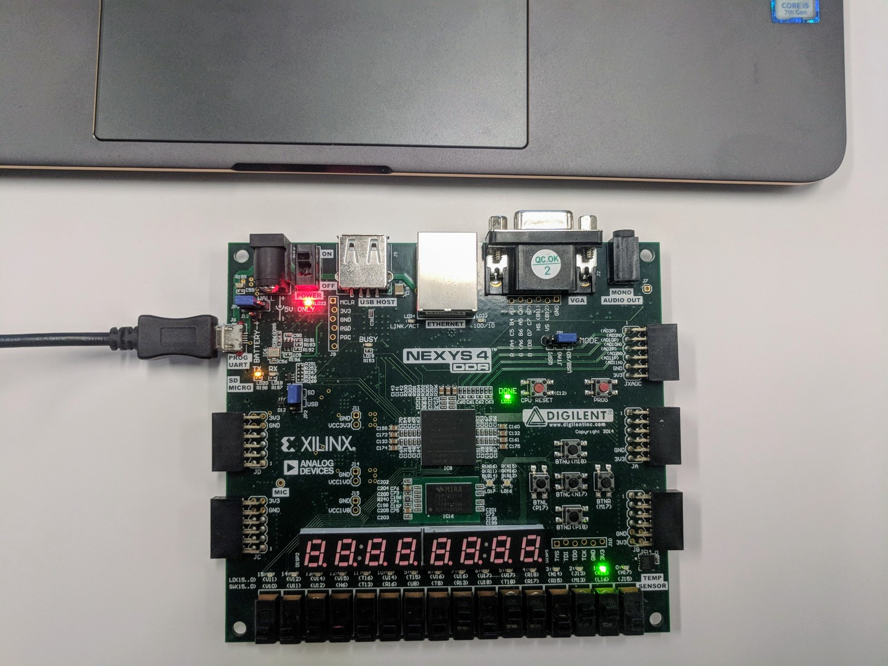
Hardware Architecture
We built a customized hardware architecture to leverage pre-defined sparsity
Key highlights:
On-device training
Edge-based
Customizable amount of parallelism
Clash free memory accesses
Pipelined processing

Slide 20
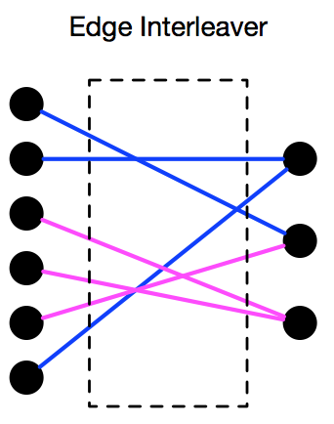
Degree of parallelism z
z_{i} = #edges (weights) processed in parallel in junction i
$$\text{\#}\text{clock} \text{cycles} \left(C_{i}\right) \text{to} \text{process} \text{junction} \text{i} = \frac{\#weights \left|W_{i}\right|}{z_{i}}$$
Computational complexity depends only on z_{i}
Decouple hardware required from network complexity
Slow
Training
z
Hardware
Intensive
Example z_{i} = 3
Flexibility
Notes:
z is also the number of MACs i need

Slide 21
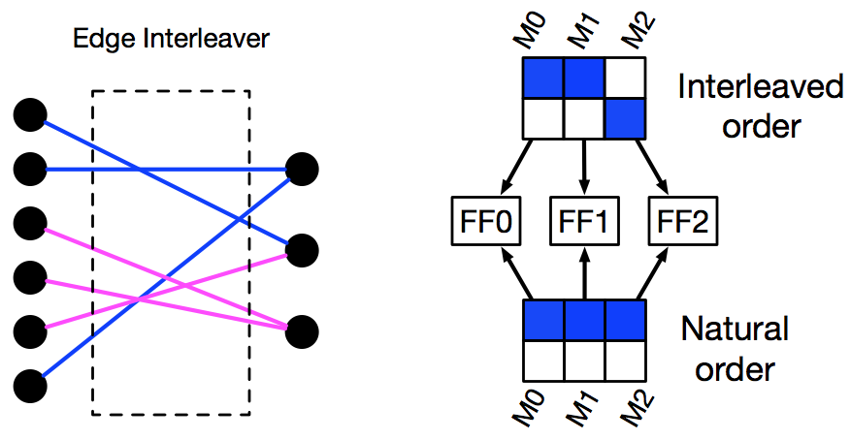
Memory organization and clash freedom
Must access each memory no more than once per clock cycle, otherwise clash => processing stall
z_{i} memories for storing each variable in each junction
Left side nodes are accessed in arbitrary order due to interleaving
S. Dey, P. A. Beerel and K. M. Chugg, “Interleaver design for deep neural networks,” in 51st Annual Asilomar Conference on Signals, Systems, and Computers (ACSSC), pp. 1979-1983, Oct 2017.
Weights are accessed one row at a time
Example z_{i} = 3

Slide 22
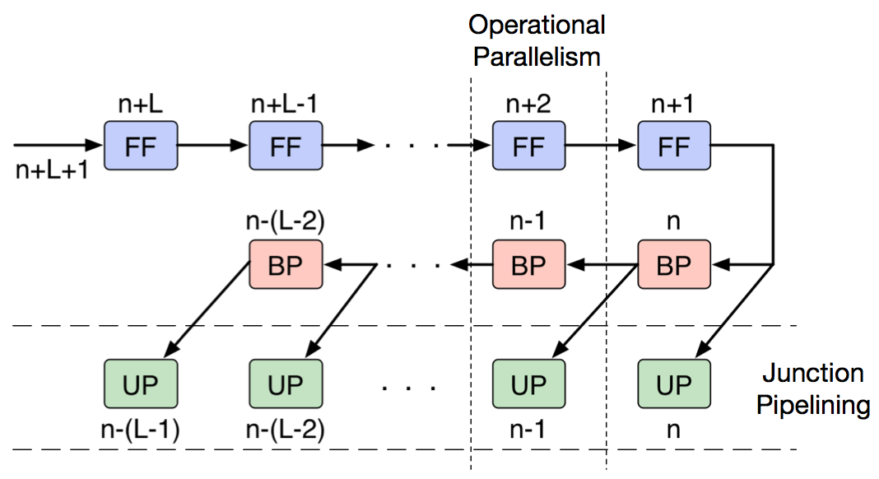
Parallel and Pipelined processing
FF, BP, UP operates only on weights which are present
Operational parallelism: FF, BP, UP simultaneously inside a junction
Junction pipelining: Each operates on different inputs across junctions
Faster training @ more hardware and storage cost
Notes:
worst case analysis - effective batch size is like 1 since I do UP after every BP

Slide 23
Model Search Automate the design of CNNs with good performance and low complexity

Slide 24
Objective
Optimize performance keeping in mind given complexity constraints
Modified loss function: f = f_{p}(Performance) + w_{c}*f_{c}(Complexity)
Gauge val accuracy from quick training runs
Wall clock time to train
w_{c}
w_{c} is like regularization
Quick to train
Sacrifice performance
Good performance
Slow to train
Slow search process
Notes:
Moving wc left on scale – performance will need to be sacrificed for hard constraints like complexity cannot be beyond some value

Slide 25
The optimization problem for f
Performance and complexity are both functions of overall config:
Discrete architecture hyperparameters (#layers, type of layer, …), AND
Continuous training hyperparameters (learning rate, decay, …)
Approaches:
Simulated annealing
Bayesian optimization
Genetic algorithms
Combination of these…
Notes:
we are doing both sets of hyperparameters

Slide 26
Bayesian optimization
Sample f(·) for n initial configs and model via a Gaussian process
Covariance
kernel k
Get potential new configs via expected improvement => Expensive f evaluations are minimized
Current best
N(0,1) cdf
N(0,1) pdf

Slide 27
Search framework
Number of convolutional layers and filters
Where to apply downsampling
Kernel sizes (including pointwise convolution)
Grouped convolutions
Batch normalization – yes/no?
Number of classifier layers, nodes, pre-defined sparsity
Learning rate and decay style
Weight decay
Batch size
Notes:
Bayesian optimization blows up if we don’t do stages

Slide 28
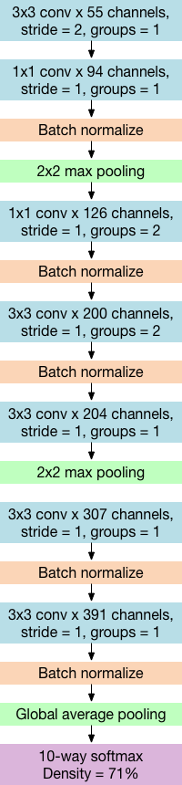
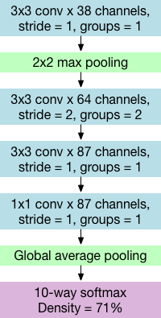
Example results for CIFAR10 w/o augmentation
w_{c} = 1
(Focus on low complexity)
w_{c} = 0.1
(More balanced case)
Learning rate = 4.3e-3
Exponential Decay = 0.999
Weight decay = 4e-4
Batch size = 501
Best val acc = 74% in 30 eps
Train time / epoch = 1 sec
Learning rate = 4.4e-3
Exponential Decay = 0.992
Weight decay = 2.3e-3
Batch size = 338
Best val acc = 82% in 30 eps
Train time / epoch = 4 sec

Slide 29

Thank you!
I plan to graduate in May 2020 and am looking for post-doc openings
(primarily on the algorithmic / software side of deep learning)

